Slide 1
Hotel Management System
PROJECT REPORT
On
MASTERS OF COMPUTER APPLICATION
Submitted BY:
Submitted To:
Name: Abhijeet Kumar UID: 24MCA20373
Section: 24MCA-6(A)
Subject Code - 24CAH-606
Mrs. Palwinder Kaur Mangat (Assistant Professor)
Chandigarh University, Mohali

Slide 2
ACKNOWLEDGEMENT
I would like to express my sincere gratitude to everyone who contributed to the development of the Hotel Management System.
First and foremost, I want to thank my mentors and instructors for their guidance and support throughout the project. Their insights into software development and the hospitality industry were invaluable.
I also extend my appreciation to my peers for their collaboration and encouragement. The brainstorming sessions and feedback helped refine the project significantly.
A special thanks to the developers of Tkinter and pymysql, whose libraries provided the necessary tools to build a robust and efficient application. Their documentation and community support were instrumental in overcoming challenges during development.
Lastly, I would like to acknowledge the hospitality industry professionals who shared their experiences and insights, which informed many of the features and functionalities in the system.
This project would not have been possible without the collective effort and support of all involved. Thank you!
———————————
——————————

Slide 3
Analysis and Critical Thinking
Functional Analysis
User Experience:
The system's graphical user interface (GUI) is designed to be intuitive, allowing staff to navigate easily. However, user testing could provide insights into any usability issues that might not be apparent during development.
Incorporating a responsive design could enhance accessibility on various devices, including tablets and mobile phones used by hotel staff.
Database Integration:
The use of MySQL for data storage is appropriate for managing guest information. However, considerations for data security, such as encryption and regular backups, are essential to protect sensitive guest data.
Implementing a more complex relational database schema could enhance data integrity and support advanced querying capabilities.
Room Management:
The current implementation uses a simple list to track available rooms. This approach works well for small hotels, but scaling this for larger establishments may require more sophisticated inventory management features, such as handling multiple room types and real-time updates.
Check-In and Check-Out Process:
The system allows for an efficient check-in process, but automating guest notifications (via SMS or email) could further enhance the experience by confirming reservations and check-in times.
Similarly, providing detailed invoices and payment processing features would improve the check-out experience and reduce manual errors.

Slide 4
Critical Thinking
Operational Efficiency:
By automating guest management tasks, the system has the potential to reduce staff workload and minimize errors associated with manual record-keeping. This can lead to improved service quality and increased guest satisfaction.
Regular analysis of guest data could provide insights into occupancy trends, allowing for better forecasting and strategic decision-making.
Scalability:
As the hotel grows, the system will need to accommodate increased data and functionality. Planning for scalability during the initial design phase will be crucial. This includes considering cloud-based solutions that can handle larger datasets and multiple users.
Competitive Advantage:
Implementing a robust hotel management system can provide a significant competitive advantage in the hospitality sector. Hotels that leverage technology effectively can improve customer service, optimize operations, and enhance guest loyalty.
Future Enhancements:
Future iterations of the system could integrate features such as online booking systems, customer relationship management (CRM) tools, and analytics dashboards to track performance metrics.
Exploring artificial intelligence for personalized guest experiences (e.g.,
recommendations based on previous stays) could set the hotel apart in a crowded market.
—————————— ——————————

Slide 5
Project Design and Implementation
Design Phases
1. Requirements Gathering:
- Engaged with stakeholders (hotel staff and management) to identify core functionalities needed, such as check-in/check-out processes, room availability management, and guest history tracking.
2. System Architecture:
The system follows a client-server architecture where the frontend (GUI) interacts with the backend (database). This separation allows for easier maintenance and scalability.
A modular design was implemented, with distinct components for user interface, data handling, and business logic.
3. User Interface Design:
Developed using Tkinter to create a graphical interface that is intuitive and visually appealing.
Ensured the design is responsive to accommodate different screen sizes and resolutions.
Used a consistent color scheme and layout to enhance usability.
Technical Implementation
1. Frontend Development:
Tkinter Library: Used for building the GUI, which includes buttons for various operations (check-in, check-out, etc.), text fields for user input, and a scrolled text area for displaying guest information.
Event-Driven Programming: Implemented event handlers for button clicks and user inputs, ensuring real-
time interactions.
2. Backend Development:
Database Design:
MySQL was chosen for data storage due to its robustness and ability to handle complex queries.
Created two primary tables: `guests` for current guests and `checked_out_guests` for historical data. The schema includes fields for name, phone, gender, email, days of stay, room number, and total cost.
Database Connection:
Used the `pymysql` library to facilitate communication between the application and the MySQL database.

Slide 6
- Functions for inserting, querying, and updating guest information were implemented to handle all database operations securely.
3. Functionality Implementation:
Check-In Process:
A form for guest information was created, allowing staff to input details easily.
Upon submission, guest data is validated and stored in the database, while the room is marked as occupied.
Check-Out Process:
Provided a dropdown menu for selecting guests to check out.
Upon confirmation, the guest's data is moved to the `checked_out_guests` table, and the room is made available again.
Room Availability:
Implemented a simple algorithm to manage available rooms, ensuring that guests can only check in if a room is free.
Guest List and History:
Created functions to retrieve and display lists of currently checked-in guests and historical data on checked-out guests, using SQL queries.
4. Error Handling and Validation:
Implemented comprehensive error handling to manage database connectivity issues and user input errors.
Input validation checks ensure that all required fields are filled out correctly, enhancing the reliability of the data entered.
Testing and Deployment
1. Testing:
Conducted unit testing for individual functions, including database operations and GUI components.
Performed integration testing to ensure all parts of the system work together smoothly.
User acceptance testing (UAT) involved hotel staff using the system in a controlled environment to identify usability issues.

Slide 7
2. Deployment:
The application was packaged for deployment on local machines at the hotel.
Provided documentation for installation and user guidance to facilitate smooth onboarding for hotel staff.
Problem Definition
Small and medium-sized hotels often struggle with keeping track of room availability, customerbilling, and basic record-keeping. Manual processes lead to inefficiency, human error, and poorcustomer experiences. The hotel management system solves these issues by:
Automating the room booking process.
Managing customer details and contacts.
Handling billing calculations for hotel stays.
Providing an intuitive user interface for non-technical hotel staff.
Objectives
Automation of customer booking: The system automates the booking process bykeeping track of available rooms and allowing hotel staff to easily input customer information.
Billing System: It calculates bills based on the number of nights a customer stays,automating manual processes and reducing errors.
Real-time Room Availability: The system tracks available rooms and updates themautomatically when a booking is made.
Data Management: Integration with MySQL allows for the permanent storage of

Slide 8
customerrecords and room availability data.
User-friendly Interface: The system uses Tkinter to create an intuitive GUI for hotel staff tointeract with.
System Design and Features
Graphical User Interface (GUI):
The front-end is designed using Python's Tkinter library, providing a clean, simple, anduser-friendly interface for hotel staff to:
Enter customer details.
Track the available rooms.
Display customer bills after processing.
The GUI consists of:
Input fields for customer details (name, ID, contact number).
Buttons for submitting the booking and inserting new data into the database.
A listbox for displaying customer bills

Slide 9
2. Database Connectivity:
The system uses MySQL (via pymysql) to store and retrieve customer and room data.
It inserts customer details and updates room availability dynamically.
The database table hotel_info is used to store key information like available rooms and rentper night.
Billing System:
The system calculates the total bill for a customer based on the number of nights stayed and the per-night room rent. If rooms are available, the booking is confirmed and room availabilityis updated in the database.
Error Handling :
The system includes error handling for cases such as attempting to book when no rooms are available. In such cases, a message box informs the user that all rooms are reserved.
Main Application: The main application window contains input fields for customer information and buttons to process bookings and insert data into the database.
Database Functions: These methods handle database interactions such as insertingdata and retrieving room availability.
Booking Logic and Billing Calculation:
The system dynamically checks room availability and processes the customer booking,updating the available room count accordingly.

Slide 10
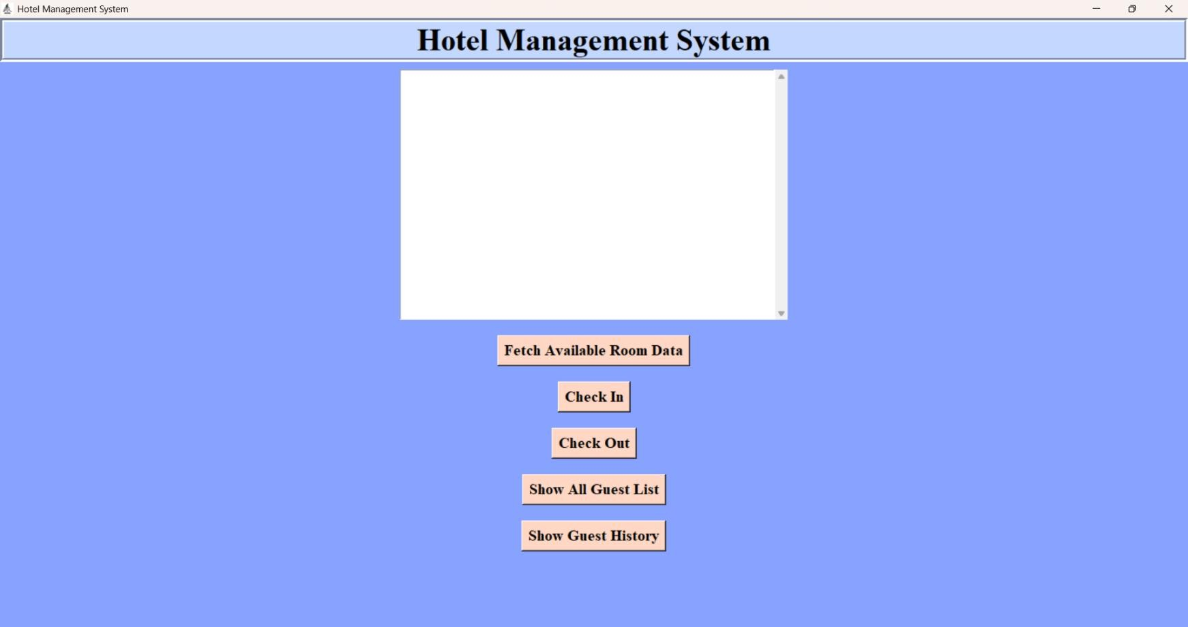
Challenges Encountered
Database Synchronization:
One challenge was ensuring that the database and the GUI remained synchronized,especially in cases where multiple bookings could occur simultaneously.
Error Handling:
Ensuring that the system properly handles edge cases, such as trying to book roomswhen none are available, was critical for a smooth user experience.
GUI Design:
Designing a GUI that is simple enough for non-technical hotel staff while ensuring ithandles all the necessary functionalities was a key challenge.
Output:

Slide 11
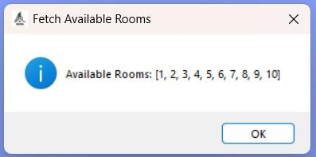

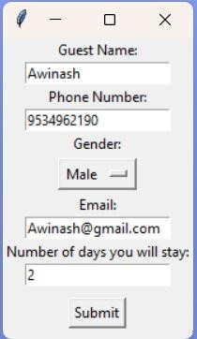
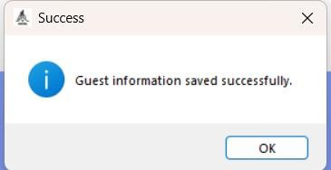

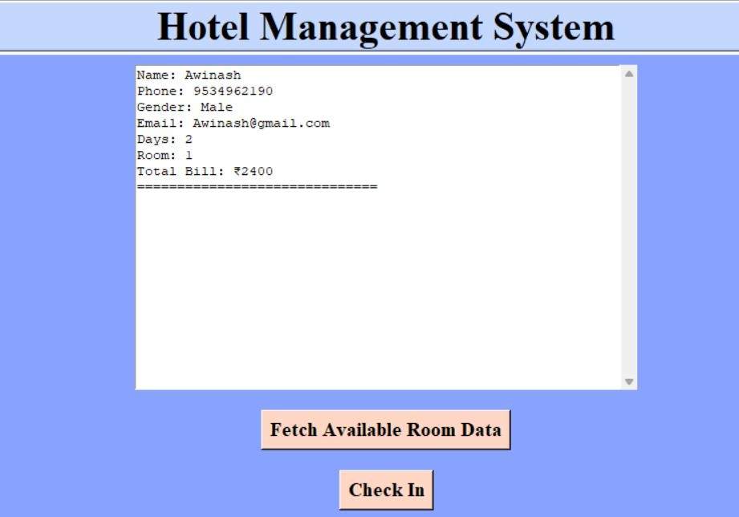
Entry Output:

Slide 12
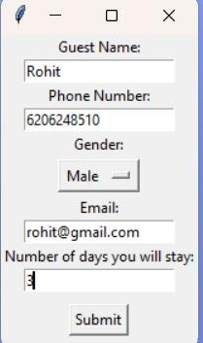
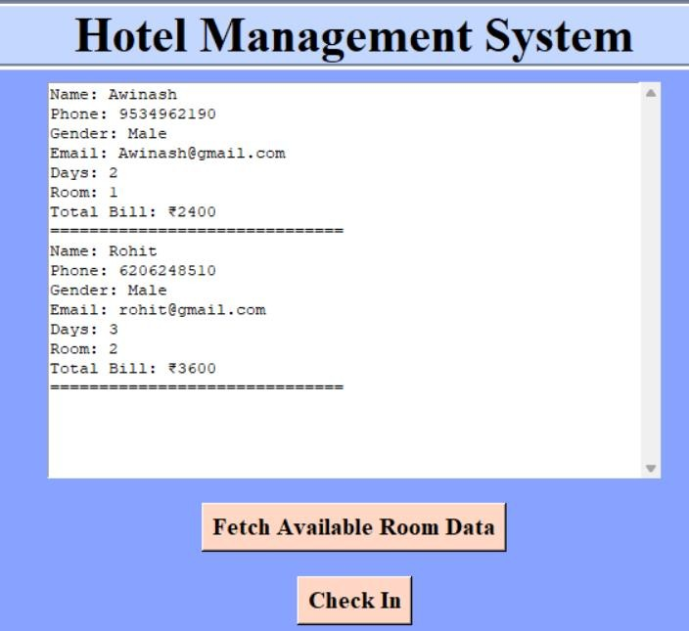

Slide 13
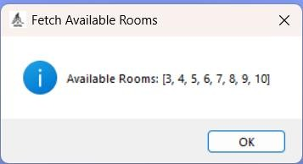
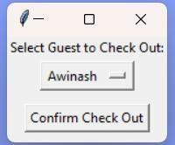
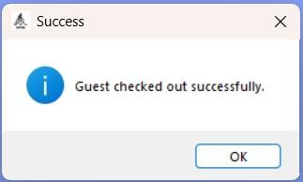

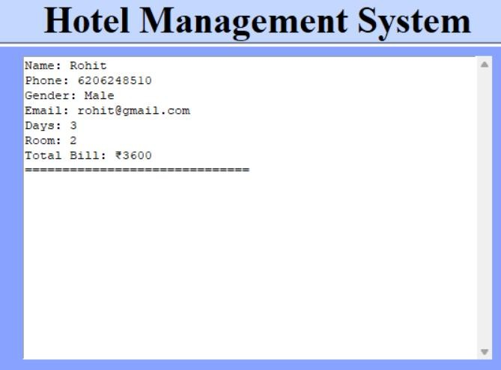

Slide 14
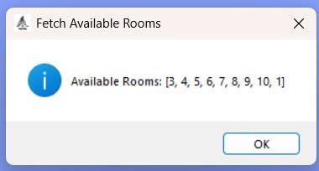
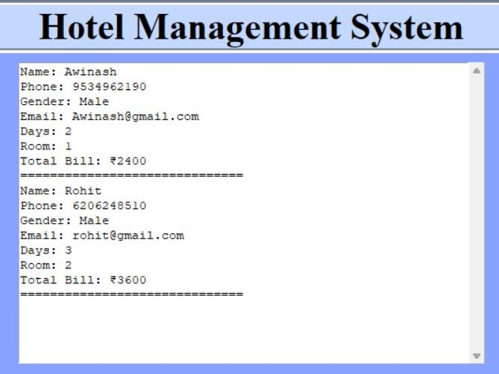

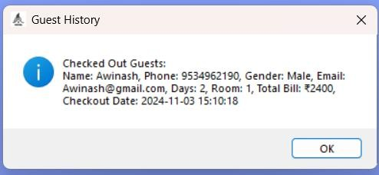


Slide 15
Conclusion
The Hotel Management System proved to be a transformative tool for Glamorous Getaways Hotel, addressing key operational challenges in booking management, billing, and room availability. By automating previously manual processes, the system enhanced efficiency, minimized human error, and improved the customer experience. Staff could nowquickly check room availability, generate accurate bills, and manage customer information,creating a seamless workflow that allowed them to focus on providing quality service. This case demonstrates how a custom-built, user-friendly solution tailored to the specific needs of a small hotel can significantly boost productivity, reduce costs, and elevate customer satisfaction, making it a valuable asset for any boutique or independent hotel operation.
Learning Outcomes
Implementing the Hotel Management System for Glamorous Getaways Hotel providedseveral key insights and takeaways:
Importance of Automation: Automating routine tasks such as booking managementand billing significantly reduces time and labor costs, highlighting the value of technology in streamlining operations in the hospitality industry.
Data Accuracy and Consistency: With automated calculations and real-time dataupdates, the risk of human error is minimized, leading to more reliable records and billing. This reinforces the importance of accuracy in customer-facing businesses where errors can
impact customer satisfaction and trust.

Slide 16
User-Friendly Interface Design: A simple, intuitive interface improves staff efficiency, demonstrating how usability is crucial for technology adoption, especiallyin businesses with minimal technical staff training.
Enhanced Customer Experience: Real-time availability tracking and quick billing processes contribute to a smooth, hassle-free experience for guests, emphasizing how internal efficiency directly impacts customer satisfaction.
References
1. Python Tkinter Documentation
Python Software Foundation. (n.d.). Tkinter — Python interface to Tcl/Tk. Retrievedfrom https://docs.python.org/3/library/tkinter.html
2. MySQL Database Documentation
Oracle Corporation. (n.d.). MySQL 8.0 Reference Manual. Retrieved from https://dev.mysql.com/doc/
Hotel Management Best Practices
Hospitality Net. (2022). Hotel Operations Management Best Practices for Efficiency. Retrieved from https://www.hospitalitynet.org/
Case Studies in Hotel Automation
Varma, A., & Sharma, S. (2020). Automation in the Hospitality Industry: Benefits andCase Studies. Journal of Hospitality and Tourism Technology, 11(3), 245-259.
Retrieved from https://doi.org/10.1108/JHTT-09-2019-0117
GitHub Link - https://github.com/abhijeet8340/Hotel-Management-System

